Slide 1
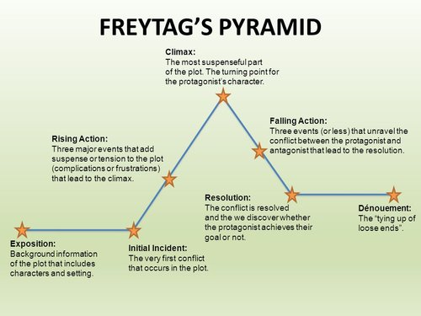
Source

Slide 2
Progress check:
Any questions from the reading?

Slide 3
There’s only 3 weeks left to do the interview(s)

Slide 4
Evaluation: 3(ish) weeks to go
Assignment status: how many interviews completed? How much drafting/editing done?
Do you need to adapt (Plan B) based on the time left?

Slide 5
Editing: The Second Draft
MED7334: Narrative

Slide 6
This week in a nutshell
Beginnings: how to use genre to give you ideas
Middles: how to maintain interest during the biggest part of your story
Show, don’t tell: how to tell stories better

Slide 7
Start with a story template
Use the form on Moodle to identify or plan elements of your story

Slide 8
An example: interviewing a teacher
Abstract:
Orientation:
Complication: tackling an increase in special needs
Evaluation:
Result:
Coda:
Part of your background research is looking for problems/challenges you can interview about. The point of your story.

Slide 9
An example: interviewing a teacher
Abstract:
Orientation:
Complication: tackling an increase in special needs
Evaluation: what does she do
Result: what happened as a result
Coda: what happens next (to her/kids/school/policy)

Slide 10
An example: interviewing a teacher
Abstract: An anecdote that sums up her challenge
Orientation:
Complication: tackling an increase in special needs
Evaluation: what does she do
Result: what happened as a result
Coda: what happens next (to her/kids/school/policy)
Once you know the complication, you know you are looking for that ‘story in a nutshell’, in the form of an anecdote. A standfirst will do this too.

Slide 11
An example: interviewing a teacher
Abstract: An anecdote that sums up her challenge
Orientation: Information about her, and the problem (stats)
Complication: tackling an increase in special needs
Evaluation: what does she do
Result: what happened as a result
Coda: what happens next (to her/kids/school/policy)
You will always need information and the 5 Ws+H (who, what, where, when, how, why) and the scale or trend (rising/falling) of the challenge

Slide 12
What to do when…
You don’t know how to start

Slide 13
Title techniques for interviews
‘Person X on A, B and C’
‘Why/how Person X did something’
‘Quote: Person X on thing Y’
Name: quote
How to do/be X: an interview with Person Y
‘Meet the person who did Y’

Slide 14
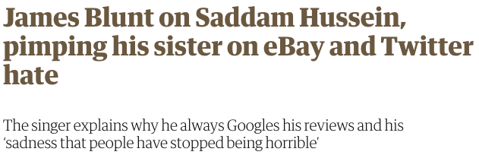
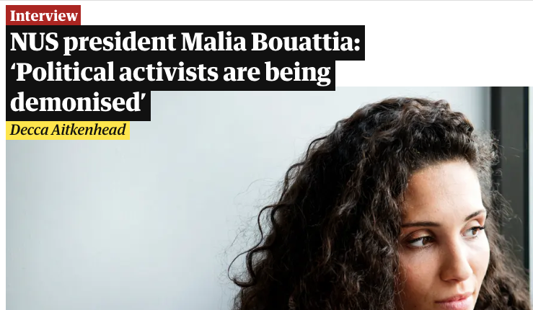
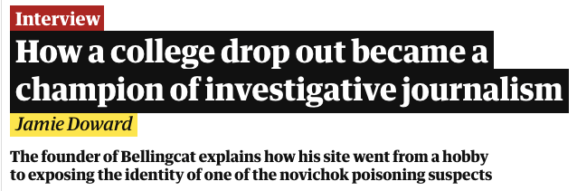

Slide 15
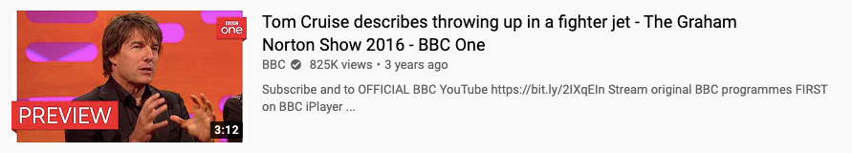
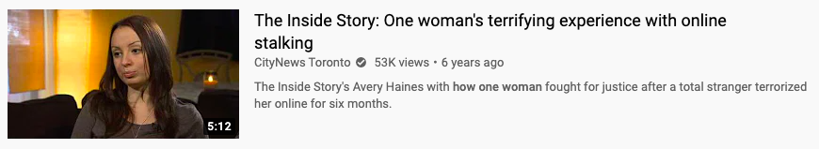
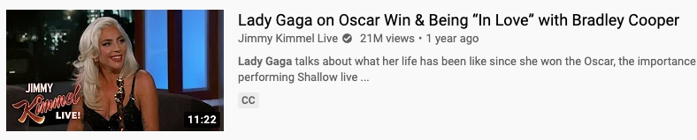
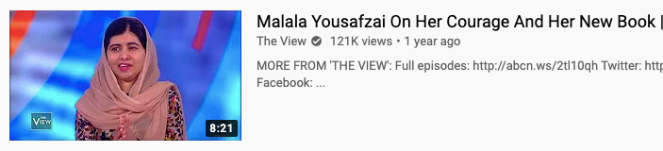

Slide 16
Don’t forget the standfirst/cue:
As farmers plan a new protest over plans to leave the EU without a deal, Jane Smith looks at the impact of Brexit on farming…
It’s 10 years since Alt-J released XX. Mo James spoke to the band about a decade at music’s cutting edge
The trend for ‘duck lips’ is over and many people are seeking to reverse their cosmetic treatments – often with painful and disfiguring results

Slide 17
Different types of “lede”* (Cox 2021)
Anecdotal
Descriptive (person/place/object)
Narrative (e.g. dialogue/scene)
Contrast lede (e.g. what should vs what does happen)
Oddity/novelty
Teaser/mystery (often with a twist)
Focus-on-a-person (embodies the issue)
One-liners
*Lede = the introductory section

Slide 18
Examples in “longform” stories
How Boots went rogue
Rise of the housing activist (start from one person)
'No one should die penniless and alone': the victims of Britain's harsh welfare sanctions (a scene)
How Nigerian young footballers are trafficked, abused, abroad (finish at one person)
Waiting for the sea (start at one place)
How Flint poisoned its people (setting/event)
Bussed out: How America moves its homeless

Slide 19
Left behind: can anyone save the towns the UK economy forgot?
Soaring antidepressant usage, falling life expectancy: Blackpool embodies much of what is going wrong on the fringes of Britain
The elephants that lumbered up and down Blackpool’s beach have long gone. Britain’s political parties have stopped decamping to the town for their annual jamborees. Even the deckchairs have left: the local government sold all 6,000 of them three years ago to a company in the affluent county of Cheshire. The one thing that hasn’t disappeared is the people.
Outside London, this resort on England’s north-west coast is one of the most densely populated places in the country. Rather than the classic downward spiral of a place in decline, Blackpool is stuck in its own strange dynamic. The more the economy rots, the more some people come.
People such as Chris Hopkins, 37, a lanky man with a curious mind and a quick tongue. Five years ago, he was living 40 miles away, working for temp agencies in unskilled factory jobs. One day, after he complained about the state of his flat, his landlord told him to move out. He went on property website Zoopla and set the filter to rank by “lowest price”. Blackpool topped the list, so that is where he went.
Sarah O’Connor, FT, November 16 2017

Slide 20
An unsolved murder at Italy’s most notorious tower block
Earlier this year, the remains of a teenage girl were found near Hotel House, a crumbling building largely occupied by recent immigrants, which many Italians regard as a den of drugs and violence. Did prejudice hamper the search for justice?
By Tobias Jones
It was raining heavily on 28 March 2018, as Alessandro Albini’s officers were raking over rough ground on the outskirts of an abandoned building. The police were looking for stashes of drugs or money, because they knew the shack was being used by dealers.
At first glance, this might have seemed an unlikely location for a drugs bust. Porto Recanati is a small seaside town on Italy’s Adriatic coast. It has perpendicular streets with low, pastel-coloured palazzi between palms and maritime pines. It’s all very neat: there are often mini-diggers on the sand, raking the beach flat as if it were a Japanese garden.
One of Albini’s men called him over. “There’s something strange here,” he said. The rain had washed away the loose soil and what looked like a golf ball was sticking out of the ground. Albini’s colleague took a cloth and wiped away the mud so that he could see the thick bone of what appeared to be a femur.
https://www.theguardian.com/news/2018/jul/31/an-unsolved-at-italys-most-notorious-tower-block

Slide 21
When filler removal goes wrong: ‘My lips and cheeks caved in’
The trend for ‘duck lips’ is over and many people are seeking to reverse their cosmetic treatments – often with painful and disfiguring results
It was her wedding photographs that did for Grace Stewart’s dermal fillers. By the time the 32-year-old married her long-term partner in 2022, she had been getting fillers for three years – first in her jaw, in pursuit of “that snatched look”, and latterly in her lips, cheeks, nose and chin. One image in particular made her do a double-take: a side-on candid shot in which she is being swept up in a hug by a cousin. “It was this really lovely moment, but all you can see is my chin curling up and this bulky jaw,” says the Nottingham-based social media manager. “I now think: ‘My Lord, why did I do that to myself?’”
Stewart did not get any further treatments in the two years after her wedding, but while hyaluronic acid filler is typically marketed as temporary – lasting up to 18 months – she couldn’t seem to shake the volume that had been injected into her jaw. So, this year, she made like Kylie Jenner, Courteney Cox and Molly-Mae Hague and had social media’s latest injection du jour: hyaluronidase, or dissolver. “I now know that there’s a reason why my face is the shape that it is. It’s not supposed to have this angle to it that doesn’t flow,” she says. “I feel so sad that I felt the need to adjust how I looked just to feel like the best version of myself.”
Evidence suggests that Stewart isn’t alone in forgoing the needle. A 2023 audit by the British Association of Aesthetic Plastic Surgeons (BAAPS) reported a 27% drop in people getting fillers compared with 2022. A cursory scroll on TikTok turns up hundreds of gory clips of young women getting hyaluronidase injected into their lips and jaws and under their eyes in the latest chapter of their “filler journey”. Celebrity doctors such as the cardiologist turned filler specialist Dr Roshan Ravindran – Dr Rosh to the faithful – have carved out a cottage industry from dissolving botched or regretted injections.
Source

Slide 22
Do it now
Use the form on Moodle to plan your story’s beginning (the abstract). It should be one of the following:
A headline + standfirst (feature)
A cue (radio) or mix (audio)
A title (YouTube video) + and opening line
An anecdote (kabob feature)

Slide 23
What to do when…
You need to keep an audience interested for longer

Slide 24
“Longform”? “Scrollytell"?
Longform: thousands of words. Often described as…
Immersive: Snow Fall-esque combination of text and multimedia, often with transitions and parallax effects
Scrollytelling: Details ‘revealed’ with scrolling

Slide 25
Source

Slide 26
Phineas & Ferb
“I know what we’re going to do today”: exposition
“Where’s Perry?”: The assignment (subplot)
Initial incident: Perry vs Doofenshmirtz
Rising action - Candace/P v D/P&F
Climax: Mom is about to see.../Perry to be defeated
Falling action: Perry defeats Doofenshmirtz...
..evidence of P&F plan disappears: resolution
Denouement: any final comments

Slide 27
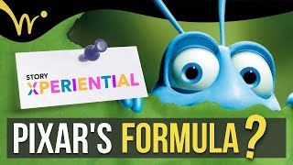
Kenn Adams’s Story Spine
Once upon a time…
Every day…
But one day…
Because of that…
Because of that…
Because of that…
Until finally…
And, ever since then…

Slide 28
An example: interviewing a teacher
Abstract: An anecdote that sums up her challenge
Orientation: Information about her, and the problem (stats)
Complication: tackling an increase in special needs
Evaluation (in a longer story):
What does she do - and what problems did she then face
What is being done about those problems? (Bigger picture)
What needs to be done — and what are the obstacles?
Result: what happened as a result for her
Coda: what happens next (to her/kids/school/policy)
You break the evaluation into chapters that ‘escalate’ the action from a specific experience to wider problems. Weave in background research or further interviews with experts and representatives

Slide 29
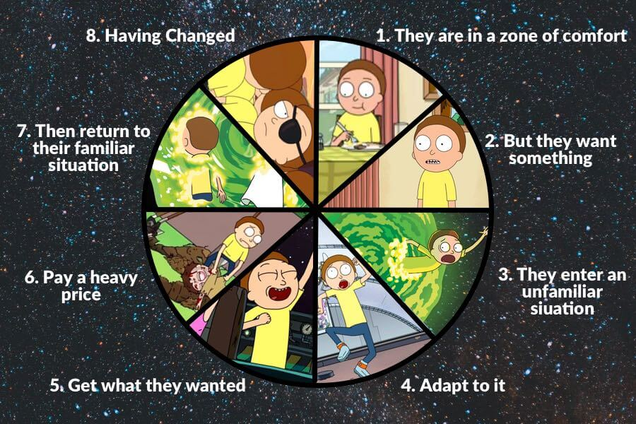
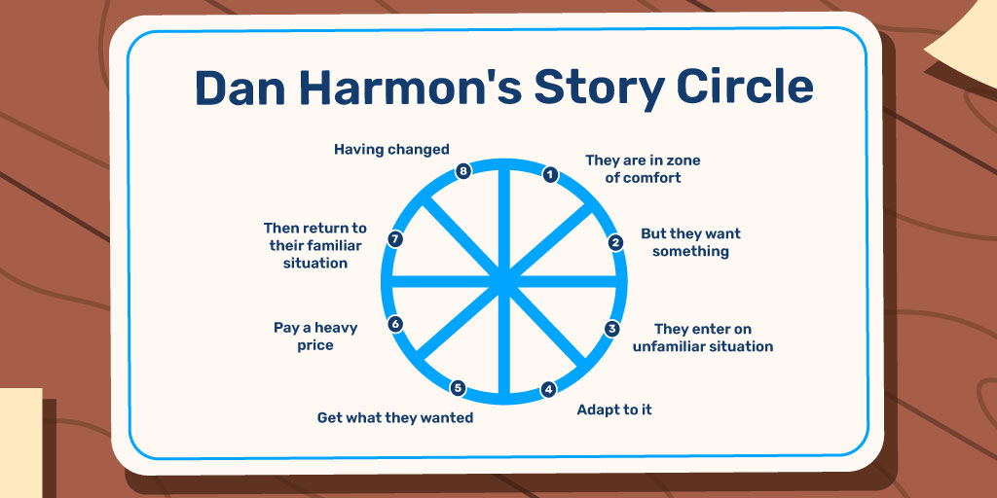
https://bookbird.io/story-structures/

Slide 30
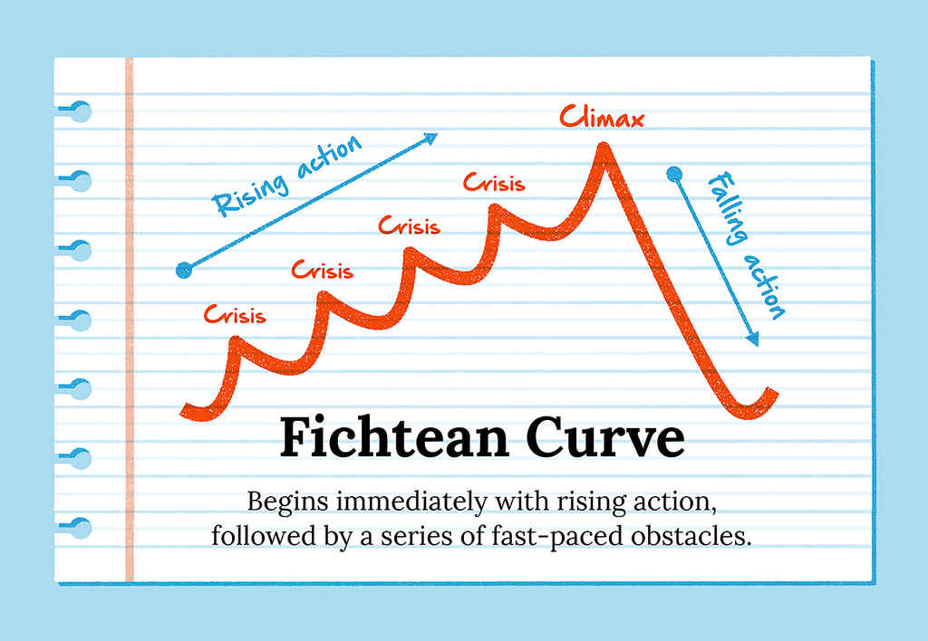
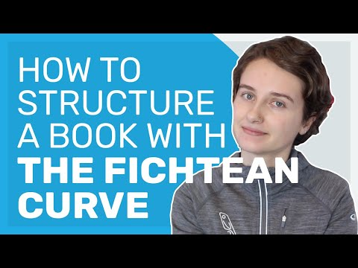
Source

Slide 31
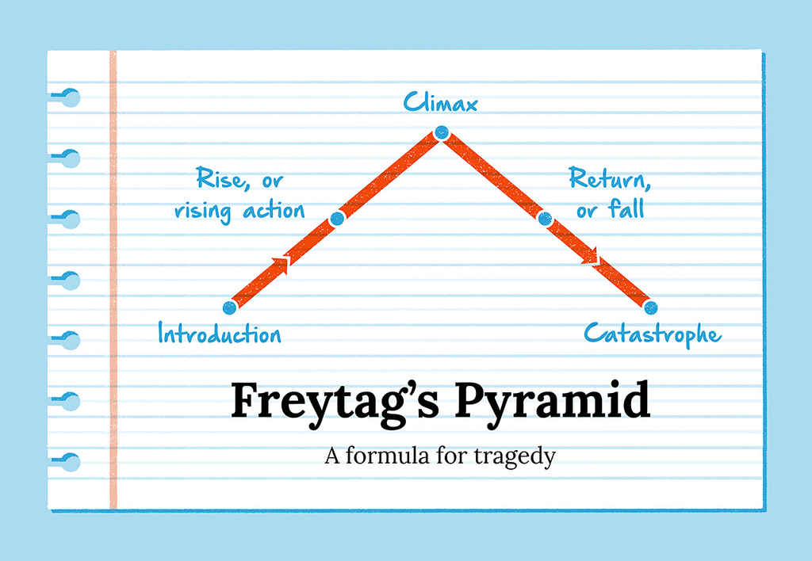
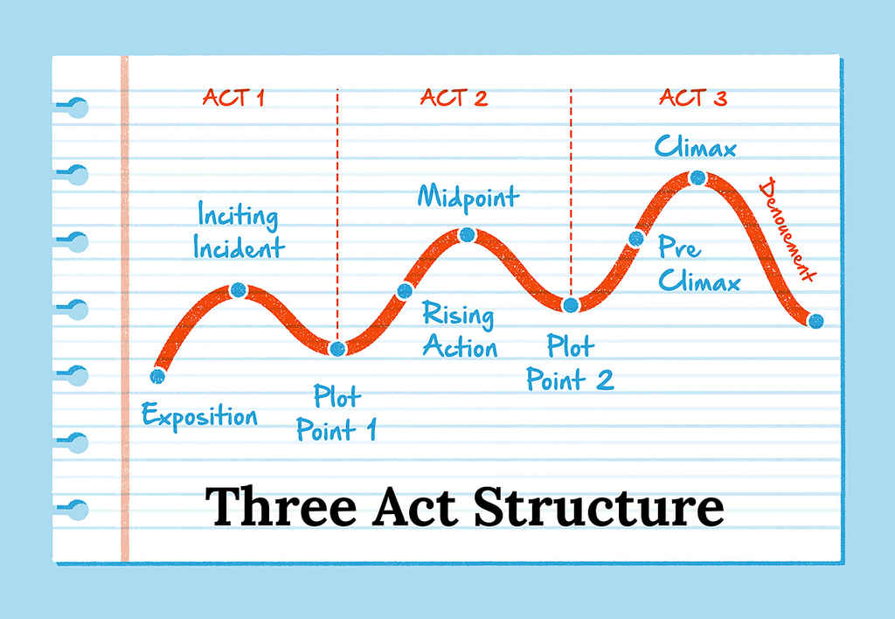
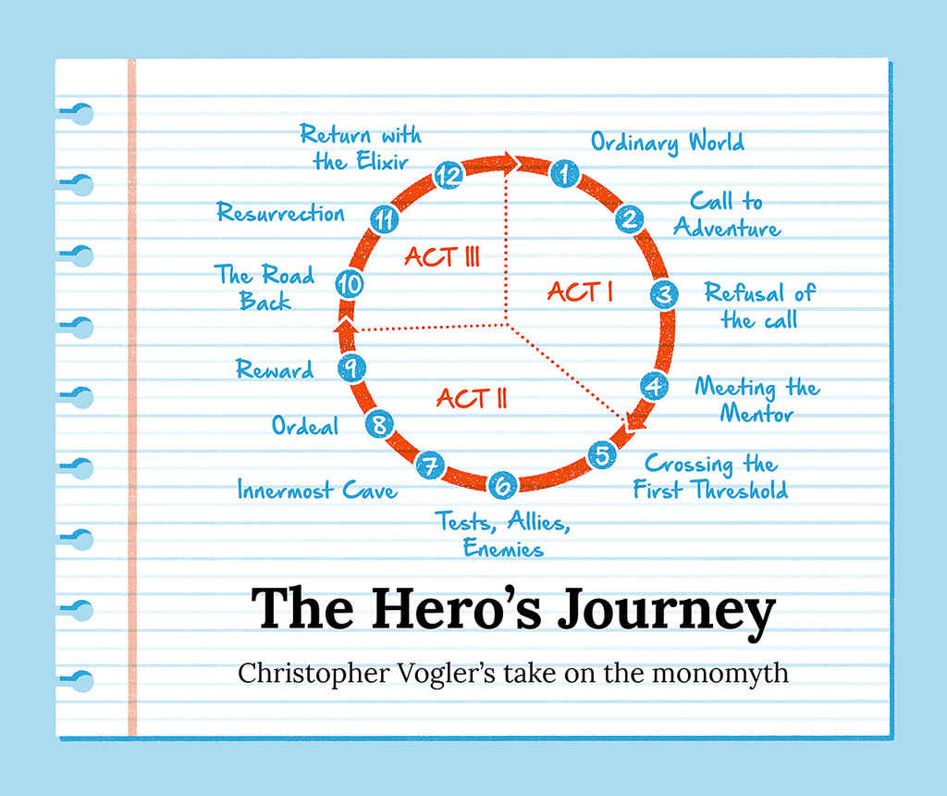
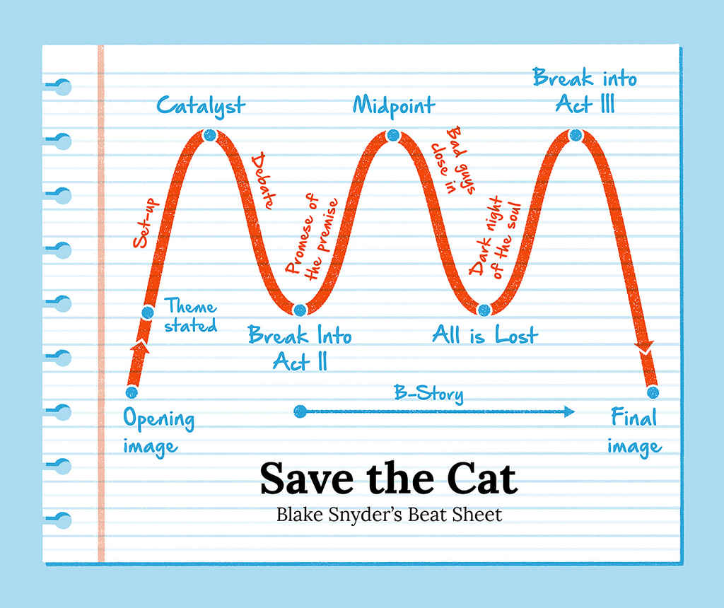
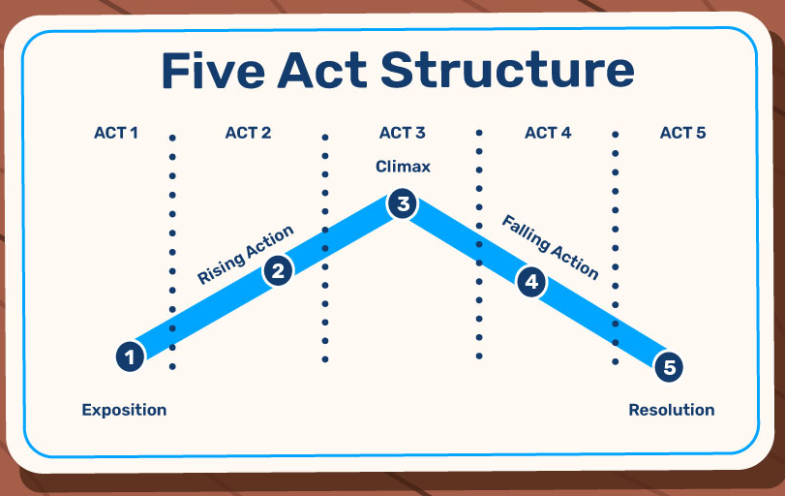
https://blog.reedsy.com/guide/story-structure/ https://bookbird.io/story-structures/

Slide 32

Identify movement in your story idea
Conflict (also: chemistry)
Causation (therefore/but)
Progression
Transformation (‘so what’)
Tip: movement between settings helps too
Baugh, Nathan (2024)

Slide 33
During the 13 years that Connie Nguyen has worked in Bay Area nail salons, she's seen numerous friends and co-workers become ill. She, too, has come down with mysterious skin rashes and respiratory problems. A few years ago, experiencing shortness of breath, she went to the doctor.
"The X-ray technician asked me if I'd been smoking a long time," said Nguyen, 48. "It shocked me. I have never smoked in my life."
Amid a booming beauty industry, California's legions of nail salon workers - most of them Asian immigrant women - are being exposed to hazardous chemicals in cosmetic products, chemicals that have largely gone unregulated because state law exempts cosmetics and personal care products.
With evidence mounting that prolonged exposure to chemicals is putting these vulnerable workers at risk for a host of health problems, state Sen. Carole Migden held a legislative hearing Thursday in San Francisco to begin assessing perils in salons. Her purpose was to establish what the state can do to protect salon workers.
Character
Movement (physical)
Movement (emotional)
Movement (small > big picture)
Movement (quest)
SFGate

Slide 34
“A good starting point would be to look for a ‘character or situation that is in flux’.”
Giles Wilson

Slide 35
“I like those moments when things suddenly make sense and you suddenly change your mind. Those are often interesting ways into a story: why someone changed their mind, or why a whole field suddenly changes something they think. I don’t think [emotion] is the only factor in any way, but it’s often a starting seed for stories.”
Sarah Zhang

Slide 36
What moves your story?
What questions are you asking to get:
Complications (conflict and chemistry/drive)
Evaluation (what happened next: therefore/but)
Results (what happened in the end: therefore/but)
Coda (thoughts/actions for the future)

Slide 37
An example: interviewing a teacher
Abstract:
Orientation:
Complication: tackling an increase in special needs
Evaluation: what did she do?
Result: what happened as a result?
Coda: what happens next (to her/kids/school/policy)?

Slide 38
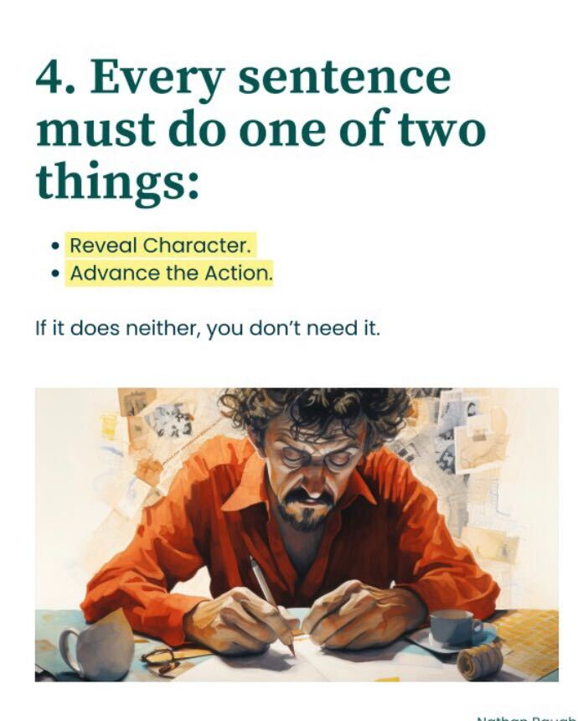
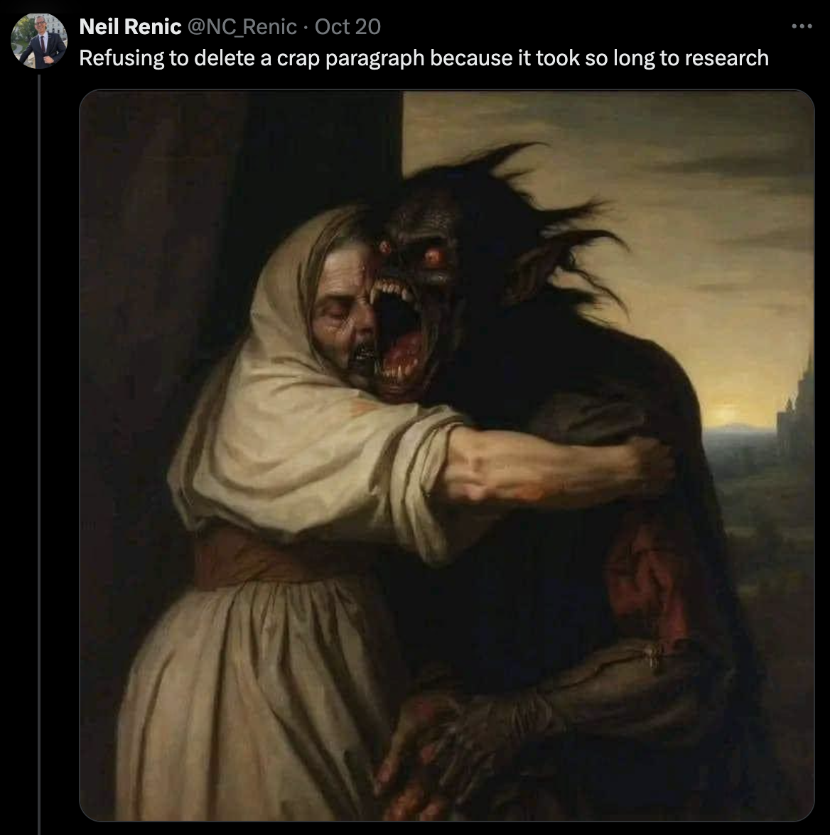

Slide 39
Story — or anecdote?
Anecdotes are just a sequence of events (without a point)
Stories have a structure — and a point
An anecdote is often part of a story (e.g. the opening) but weave in the ‘point(s) of reflection’ mentioned by Ira Glass

Slide 40
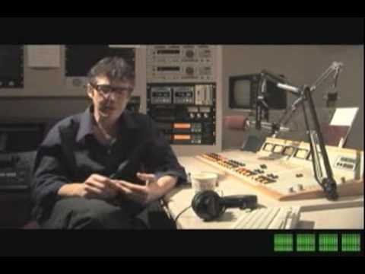
...And a point.
For example: Apple Clips story
Ira Glass on storytelling
Notes:
S-Town is a compelling setting, and the story hinges on a compelling, unusual character. The question the structure raises is: where is this going? What’s the movement? If you listen carefully you can guess what’s going to happen.

Slide 41
During the 13 years that Connie Nguyen has worked in Bay Area nail salons, she's seen numerous friends and co-workers become ill. She, too, has come down with mysterious skin rashes and respiratory problems. A few years ago, experiencing shortness of breath, she went to the doctor.
"The X-ray technician asked me if I'd been smoking a long time," said Nguyen, 48. "It shocked me. I have never smoked in my life."
Amid a booming beauty industry, California's legions of nail salon workers - most of them Asian immigrant women - are being exposed to hazardous chemicals in cosmetic products, chemicals that have largely gone unregulated because state law exempts cosmetics and personal care products.
With evidence mounting that prolonged exposure to chemicals is putting these vulnerable workers at risk for a host of health problems, state Sen. Carole Migden held a legislative hearing Thursday in San Francisco to begin assessing perils in salons. Her purpose was to establish what the state can do to protect salon workers.
The ‘moment of reflection’ (aka the “nut graf”)
SFGate

Slide 42
Do it now
Use the form on Moodle to enter your story’s point:
Why does it matter?
How will this be useful to us?

Slide 43
An example: interviewing a teacher
The increase in special needs is:
Affecting thousands of teachers
Leading to students not achieving their potential
Costing (the taxpayer/parents) money

Slide 44
Complication:
Rising action:
You want to tell
stories better

Slide 45
Things to consider:
Choices to make about the narrator
Tools to consider around temporality and pacing
How to use showing vs telling in your work

Slide 46
Speaking subject vs subject of speech
“The actor said” (effaced narrator)
“The actor told the BBC” [“we”]
“I had decided to spend a day in the life of a vet” [first person]

Slide 47
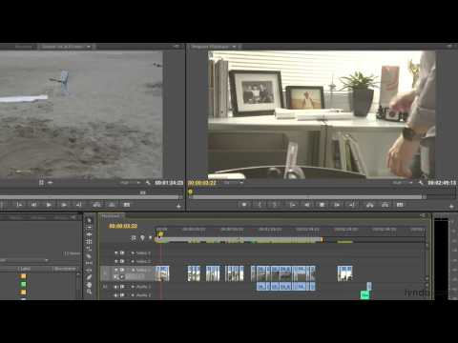
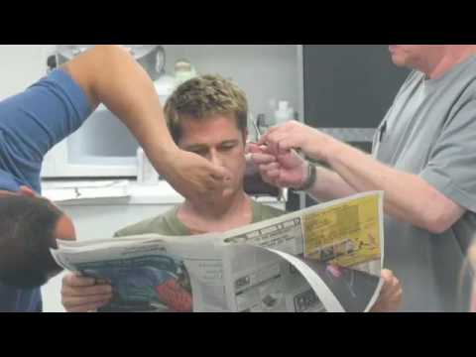
Temporality
Notes:
Stories can be told chronologically. Or they can switch between periods. They can go backwards. Stories can unfold in real time, or in hyperlapse, or slow motion.

Slide 48
Duration and pacing
“The relationship between a duration (story events) and length (text/etc)”

Slide 49
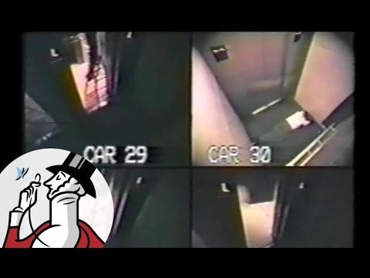

Slide 50
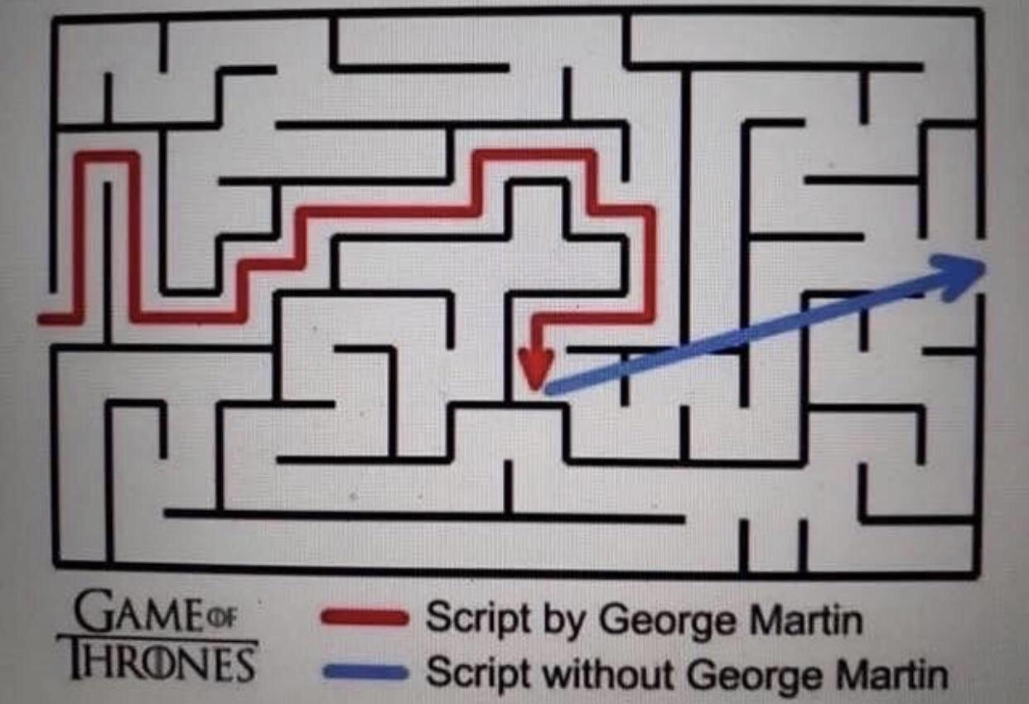
Temporality
Notes:
Stories can be told chronologically. Or they can switch between periods. They can go backwards. Stories can unfold in real time, or in hyperlapse, or slow motion.

Slide 51
Pace and direction (Nathan Baugh)
Fast Pace, Wrong Direction: | Action-packed scenes that don’t move your story closer to a goal. Entertaining at first, but eventually, your audience wonders, "Where is this going?" Example: Lots of details, tangents, anecdotes, side plots but no objective.
Fast Pace, Right Direction (Ideal): | Every scene moves closer to a defined goal. Fast pacing is matched with clear direction. Example: Quickly overcoming obstacles or steadily gaining insights that visibly move toward your Keystone Moment.
Slow Pace, Right Direction (Also effective): | Slow pace but steady, purposeful movement toward your ending / Keystone Moment. Your audience remains engaged because they sense direction. Example: Reflective moments tied to deeper understanding or character change
Slow Pace, Wrong Direction (Avoid at all costs): | Meandering pace without direction. Audiences quickly lose interest because it feels pointless.

Slide 52
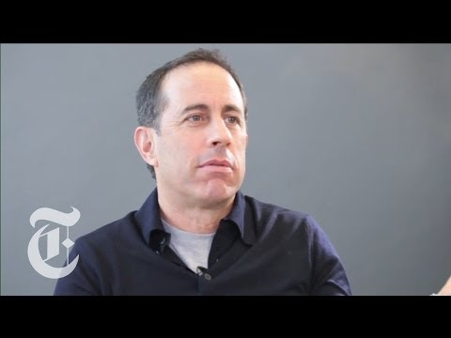
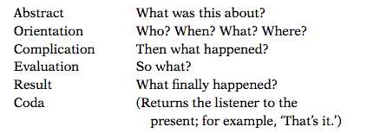
https://www.youtube.com/watch?v=itWxXyCfW5s

Slide 53
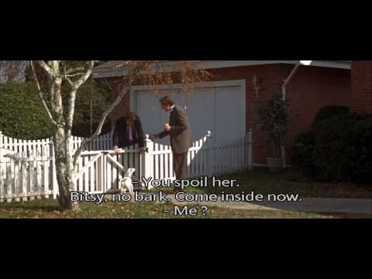
Prolepsis and analepsis (flash forward & flashback)
“I’m 42 years old. In less than a year, I’ll be dead”
https://www.youtube.com/watch?v=XMqwSTe5rvo / https://www.youtube.com/watch?v=Hx0bcEFkn_U&t=1m25s

Slide 54
Workshop it!
How do you plan to use time in your story?

Slide 55
Make it better:
Show (don’t tell)

Slide 56
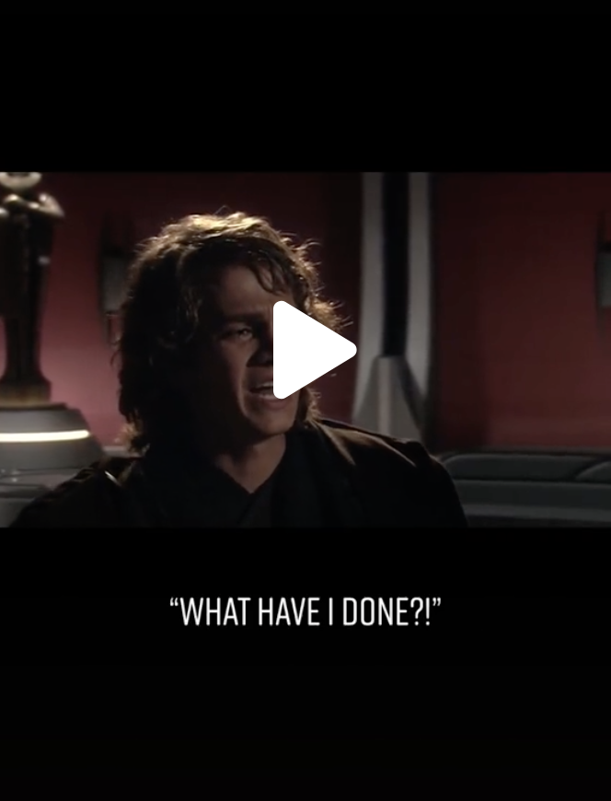
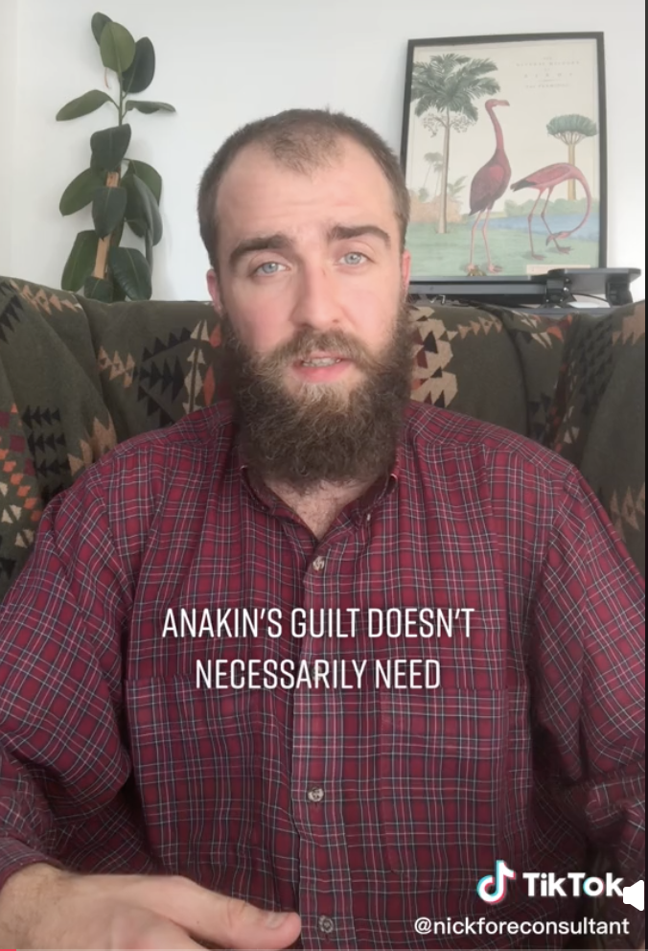
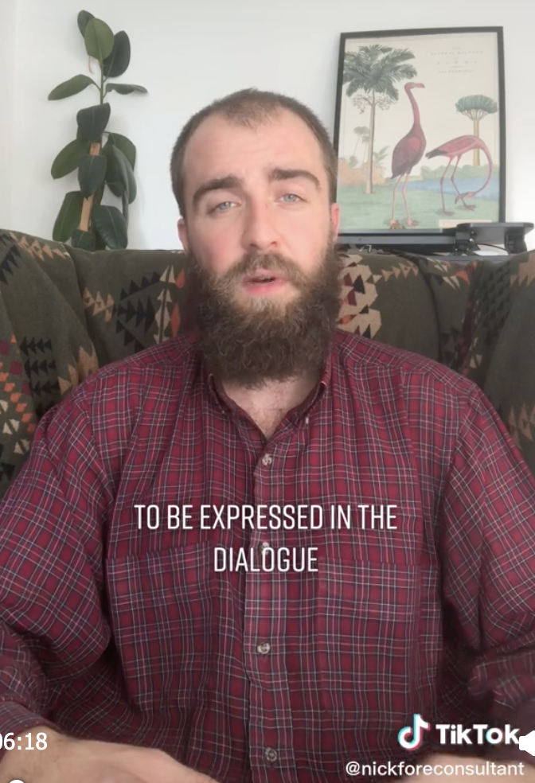
Mimesis vs diegesis (“show, don’t tell”?)
https://www.tiktok.com/@nickfore.scripts/video/7159149400021847302
Notes:
From Plato & Aristotle in Socrates: diegesis is direct representation - a narration; mimesis involves ‘showing, not telling’, for example by playing (‘representing’) actions and characters, and is action-driven. Drama is mainly mimesis; epic poetry is mainly diegesis.

Slide 57
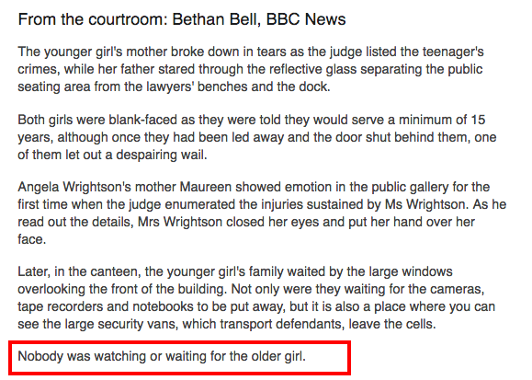
Mimesis and diegesis (telling and showing)
Notes:
From Plato & Aristotle in Socrates: diegesis is direct representation - a narration; mimesis involves ‘showing, not telling’, for example by playing (‘representing’) actions and characters, and is action-driven. Drama is mainly mimesis; epic poetry is mainly diegesis.

Slide 58
See also: Hemingway’s Iceberg
“When you omit [telling] a piece of your story, your audience doesn’t just skip that part. Instead, you entice your audience to use their imagination. To make their own inferences. Your audience fills in the story for you [from what is shown].”
Baugh 2024

Slide 59
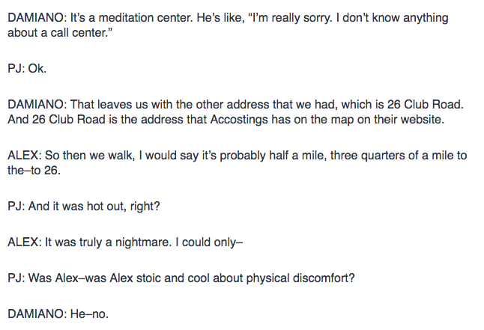
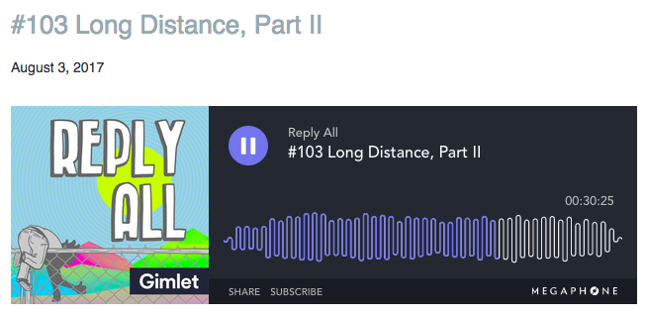
Show, then tell to ‘cut’ to the next part
https://gimletmedia.com/shows/reply-all/6nh3wk
Notes:
Emojis and gifs are the perfect modern example of mimesis

Slide 60
An interview...
“Suggests both a mimetic representation of a conversation and an actual chronology and temporality. It wants readers to forget that it is an interpretation of a conversation.”
Broersma 2008

Slide 61
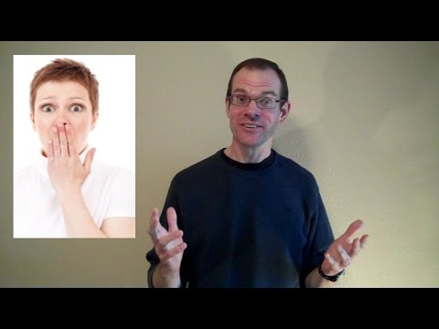

Slide 62
Workshop it!
Are there opportunities to replace diegesis (telling) with mimesis (showing)
What questions do you need to ask to ‘show’ instead of ‘tell’?
What media could you create or obtain?

Slide 63
Result:

Slide 64
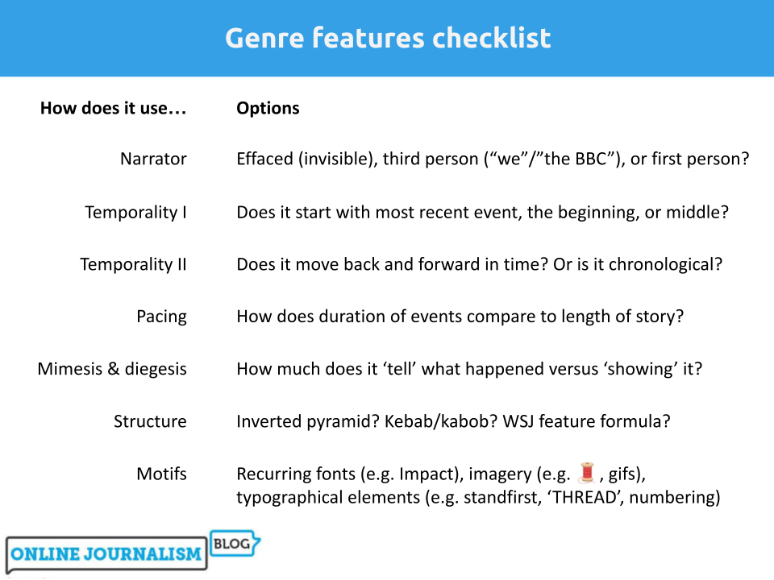

Slide 65
This is what you should know.
Consider ‘chapters’ or Freytag’s Pyramid for longer formats
Look at examples in your genre and how they use temporality, pacing, narration and other devices
Show if you can. Tell if you can’t.

Slide 66
Directed study
Read about narrative techniques on Moodle
Work on your assignment: it matters less who the interview is with - the most important thing is you using these techniques to ask the best questions, and shape the results into a story.

Slide 67
Bonus material

Slide 68
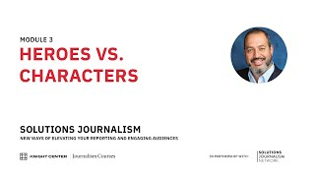

Slide 69
Inverted pyramid (note temporality*)
1. Start with the new thing - NOT background [PROLEPSIS]
2. Back in time: context (“it comes after”)
3. Return to present: reaction
4. Move back and forth in time to context and reaction
End: Resolution: a quote, or what happens next - NOT what you think
*Temporality = the use of time

Slide 70
For example: someone has been injured
Do you start with “Last night at 11pm...”?
Do you start with “On Broad Street in Birmingham...”?
Or…
Do you start with:
“A man has been injured...”? (And fill in the when/where after)

Slide 71
For example: an interview-based update
Do you start with “Ruth Wilson started acting at school”?
Do you start with “Ruth Wilson is best known for her role….”?
Or…
Do you start with:
“The actor Ruth Wilson has hit out at the “hypocrisy” of Hollywood...”? (And fill in the where/why/who after)

Slide 72
An alternative
A brother and sister have been injured after falling down a hill. (abstract)
The incident took place on Water Hill in Moseley.
Jack and Jill Smith were fetching a pail of water when they slipped. (complication)
Jack suffered a head injury and was rushed to hospital. (evaluation + result)
He is expected to make a full recovery. (coda)

Slide 73
Alternate between elements
1. Facts
2. Background
3. Quote
4. Facts
5. Quote
6. Background
7. Quote

Slide 74
Alternate between elements
1. Doctors leaders are warning that...
2. Analysis by the ABC said
3. Chairman Dr Claire Gerada said “...”
4. In 2012-13 £34bn was invested
5. “It is a disaster,” Gerada said. “...”
6. On Tuesday the Prime Minister said he...
7. “That’s why this week we announced”

Slide 75
Alternate between elements
The actor Ruth Wilson has hit out…
Wilson, star of Luther, The Affair and His Dark Materials, said…
Background facts
Wilson reportedly left The Affair due to…
More context
Quote that looks ahead

